Slide 1
Data Flow Diagrams

Slide 2
What is a Data Flow Diagram?
A data flow diagram (DFD) is a graphical representation of the movement of data between external entities, processes and data stores within a system.
Simply put, DFD’s show how data moves through an information system.

Slide 3
Symbols and Notations Used in DFDs
External entity: an outside system that sends or receives data, communicating with the system being diagrammed. They are the sources and destinations of information entering or leaving the system
Process: any process that changes the data, producing an output. It might perform computations, or sort data based on logic, or direct the data flow based on business rules. A short label is used to describe the process, such as “Submit payment.”

Slide 4
Symbols and Notations Used in DFDs
Data store: files or repositories that hold information for later use, such as a database table or a membership form. Each data store receives a simple label, such as “Orders.”
Data flow: the route that data takes between the external entities, processes and data stores. It portrays the interface between the other components and is shown with arrows, typically labeled with a short data name, like “Billing details.”

Slide 5
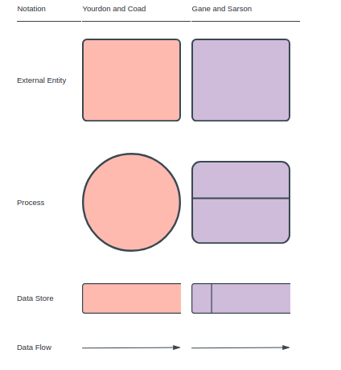
Symbols and Notations Used in DFDs

Slide 6
DFD rules
Each process should have at least one input and an output.
Each data store should have at least one data flow in and one data flow out.
Data stored in a system must go through a process.
All processes in a DFD go to another process or a data store.

Slide 7
DFD levels and layers
A data flow diagram can be represented into progressively more detail by using levels and layers, zeroing in on a particular piece.
DFD levels are numbered 0, 1 or 2, and occasionally go to even Level 3 or beyond.
The necessary level of detail depends on the scope of what you are trying to accomplish.
Levels of DFD
0-level DFD: It represents the entire system as a single bubble and provides an overall picture of the system.
1-level DFD: It represents the main functions of the system and how they interact with each other.
2-level DFD: It represents the processes within each function of the system and how they interact with each other.
3-level DFD: It represents the data flow within each process and how the data is transformed and stored.

Slide 8
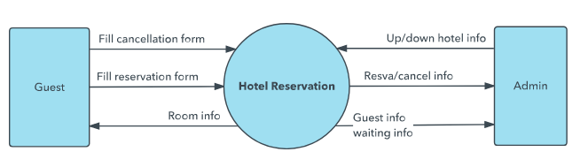
DFD Level 0-Context Diagram.
basic overview of the whole system or process being analyzed or modeled.
It’s designed to be an at-a-glance view, showing the system as a single high-level process, with its relationship to external entities.
Its used by a wide audience, including stakeholders, business analysts, data analysts and developers to understand the system.

Slide 9
DFD Level 1
It provides a more detailed breakout of pieces of the Context Level Diagram.
It highlights the main functions carried out by the system, as we break down the high-level process of the Context Diagram into its subprocesses

Slide 10
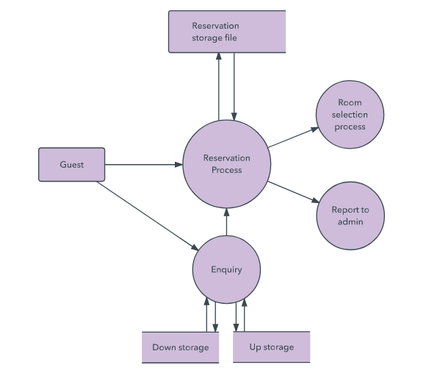
DFD Level 1

Slide 11
DFD Level 2
It goes one step deeper into parts of Level 1.
It may require more text to reach the necessary level of detail about the system’s functioning.

Slide 12
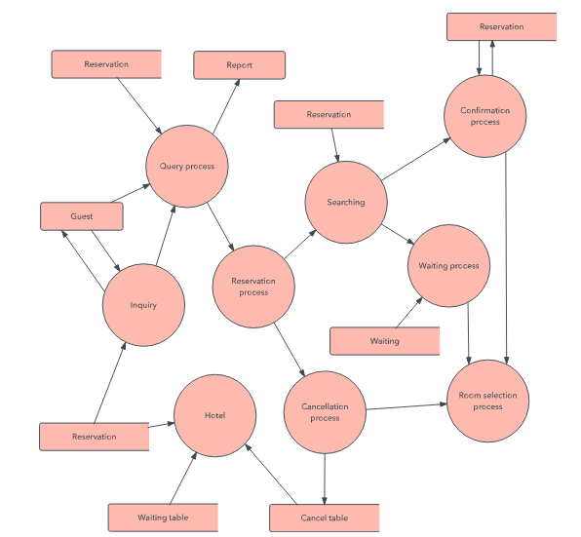
DFD Level 2

